Slide 1
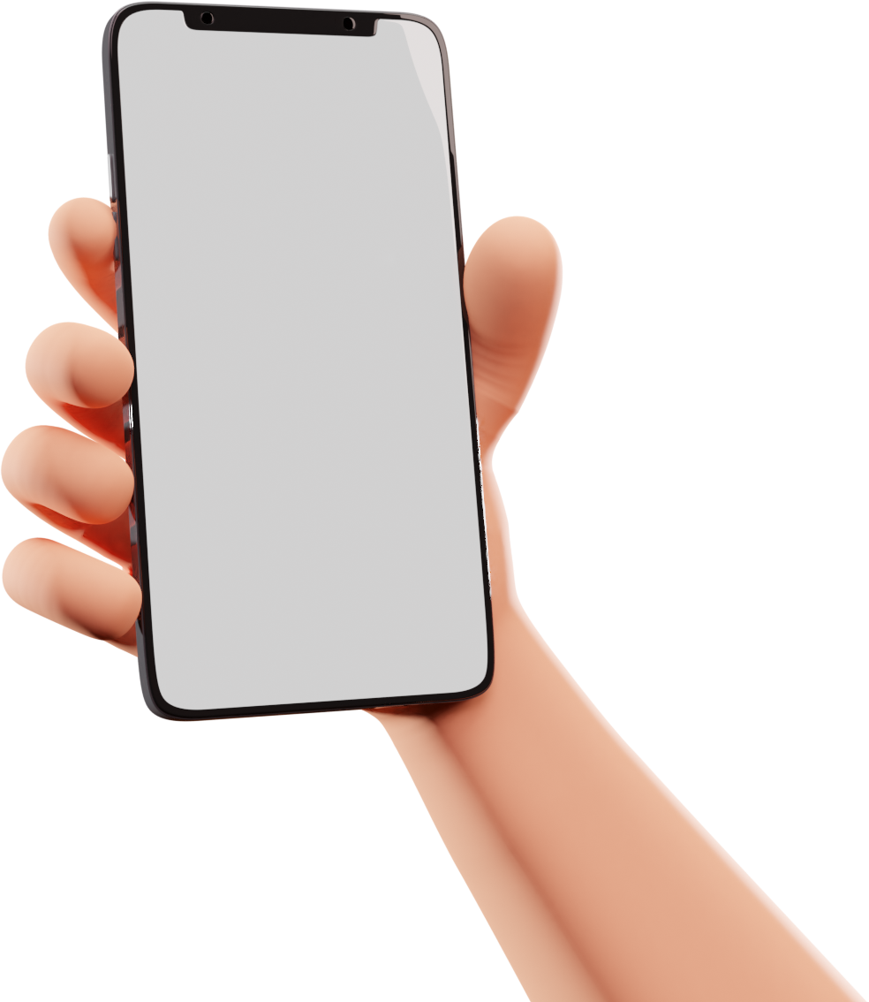
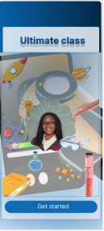
Mobile development
ULTIMATE CLASS APP
PRESENTATION
Presented by The Boys

Slide 2
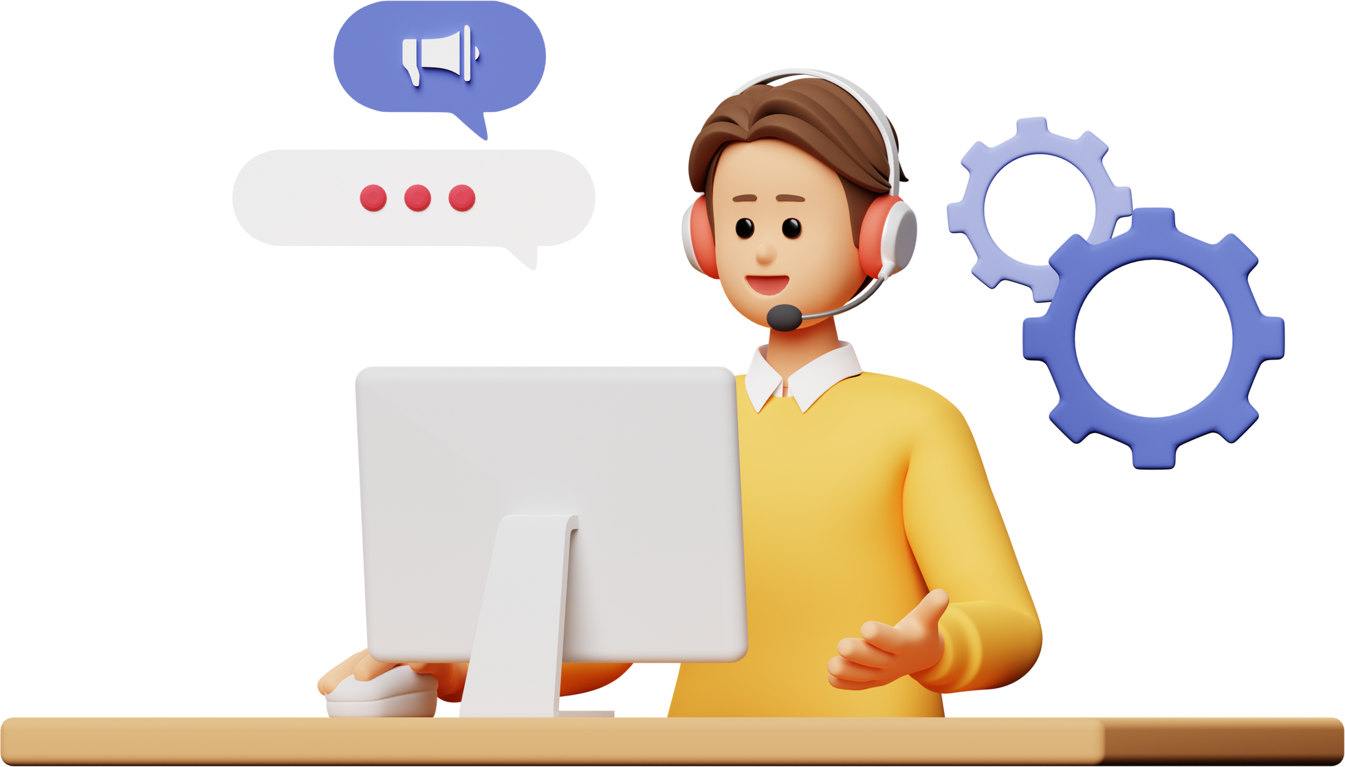
ABOUT US
WHY U.C APP ?
Ultimate class app, is a school communication genius.
As it is students spend most of their time on the internet and having a reliable convenient app would be a lifesaver
Students get information about classes in real-time.
Quickly. Swiftly. Efficiently

Slide 3
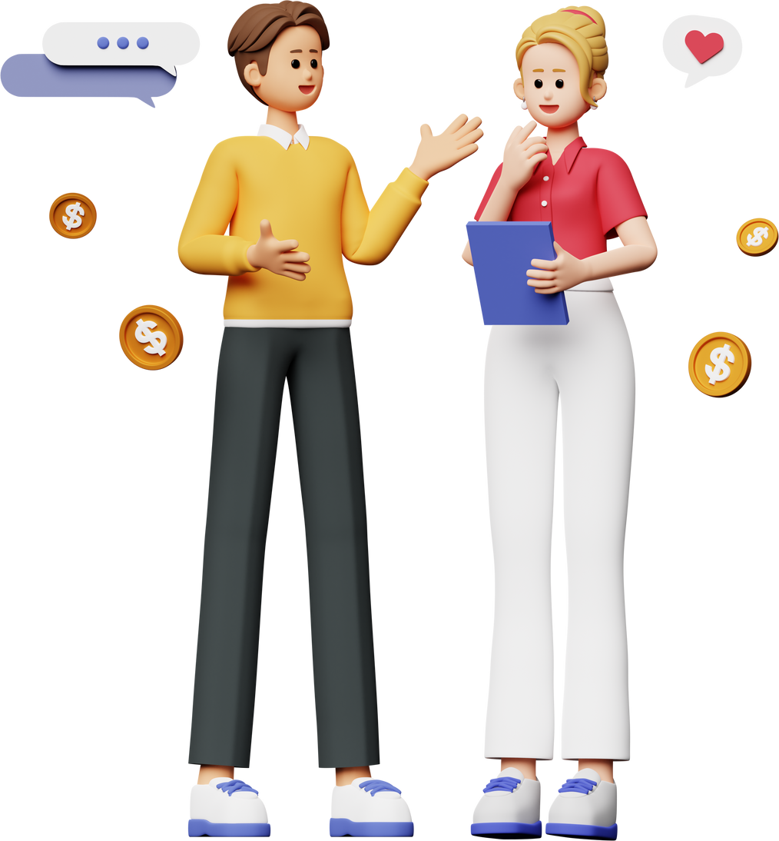
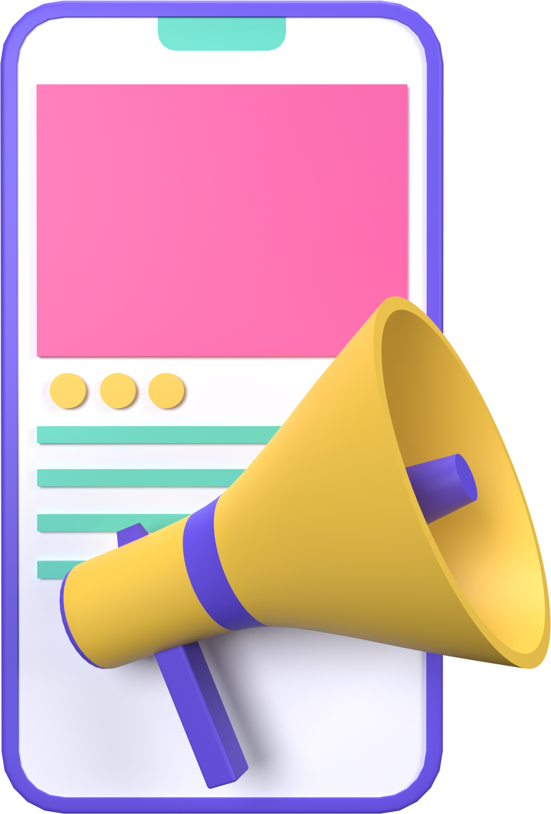
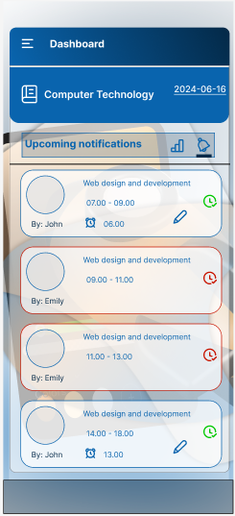
COMMUNICATIONS
SMART ACCESS
THE FUNCTIONING
Lecturer updates
Timetable update
Lecturer
class-representative
class-representative updates timetable and confirms

Slide 4
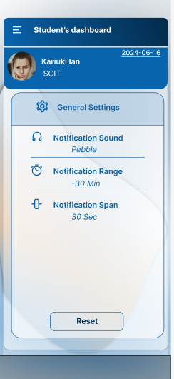
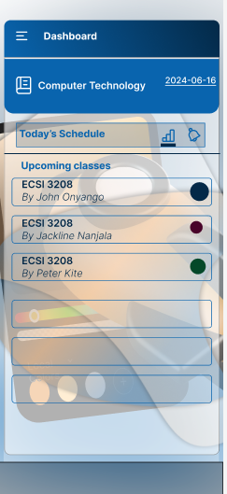
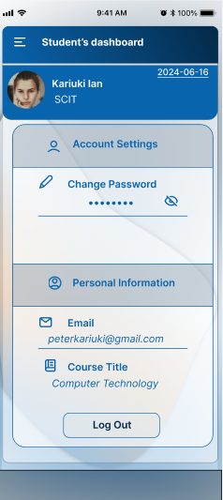
UI FRIENDLY
simple layout
incredibly intuitive
optimized for a smooth user experience, minimizing complexity and enhancing usability.

Slide 5


IMPACT
CLASS PERFORMANCE
Students get notified in real-time and swiftly
Reliable source of communications for lectures
All communications are done with efficiency as a goal

Slide 6


DEVELOPERS
THE BOYS
Rashid Isaak
SCCI/0000/2021
Computer Technology Students
FELIX KEMBOI
SCCI/0000/2021
Ezekiel Njeri
SCCI/0000/2021

